Slide 1
Quanda Chatbot
Team 5 : Andrew Frederick, Mike Moll, Manahil Nasim
Notes:
Hello, today we are going to explore the exciting world of Natural Language processing and creating generative artificial intelligence chatbots. Team 5 is comprised of Andrew Frederick, Mike Moll, and Manahil Nasim. This presentation is a part of AAI 520 at the University of San Diego.

Slide 2
Technology Infographics
Objective
To create an intelligent chatbot.
Dataset
Stanford Question Answering Dataset (SQuAD).
Mission
Our mission is to revolutionize the way we interact with technology, and "Quanda" is a significant step in that direction.
Notes:
We’re excited to take you on a journey through the development of our chatbot project, "Quanda." This presentation outlines our process and demonstrates the potential of leveraging the Stanford Question Answering Dataset (SQuAD) to create an intelligent and effective chatbot. Our mission is to revolutionize the way we interact with technology, and "Quanda" is a significant step in that direction.

Slide 3
Introduction & Background Research
Introduction to Natural Language Processing (NLP)
Importance of chatbots in various industries.
Overview of the SQuAD dataset.
Notes:
Our project is rooted in Natural Language Processing (NLP), a field that has transformed the way we interact with technology. Chatbots, in particular, are making waves in various industries, from customer service to search engines. The SQuAD dataset, derived from Wikipedia, serves as a robust resource for our chatbot's development. Furthermore, we harnessed the power of transformers, such as BertTokenizer, to excel in NLP tasks.

Slide 4

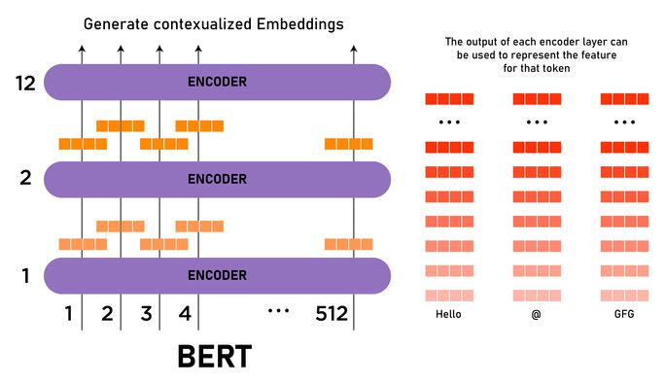
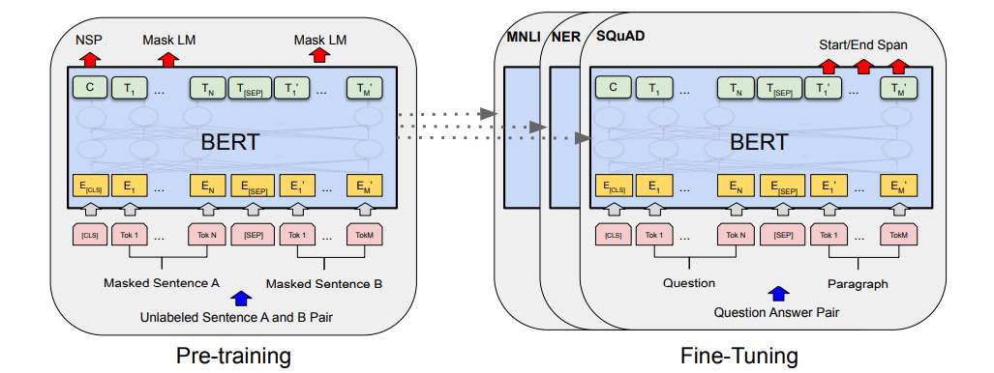
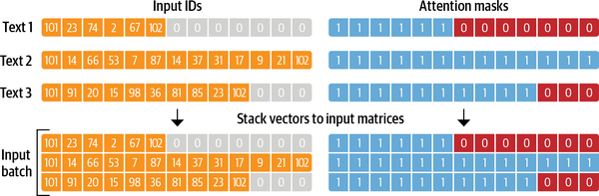
Data Selection and Preparation
Notes:
The data selection and preparation process for our BERT-based Question Answering system. We start by loading our training and development datasets from JSON files. This data is then tokenized using BERT's specialized tokenizer, ensuring it's in a format suitable for our deep learning model. One of the challenges in tokenization is managing longer texts that don't fit within BERT's input limit. We address this by handling token overflows and adjusting the positions of our answers accordingly. Once our data is prepared, we set up our training environment. This includes initializing our BERT model specifically designed for question answering, and setting up our training loop. Throughout this process, the emphasis is on careful and precise data handling to ensure our model is trained on high-quality, well-prepared data.This is not an easy process, and there is still room for improvement when it comes to handling overflowing tokens in our training.

Slide 5
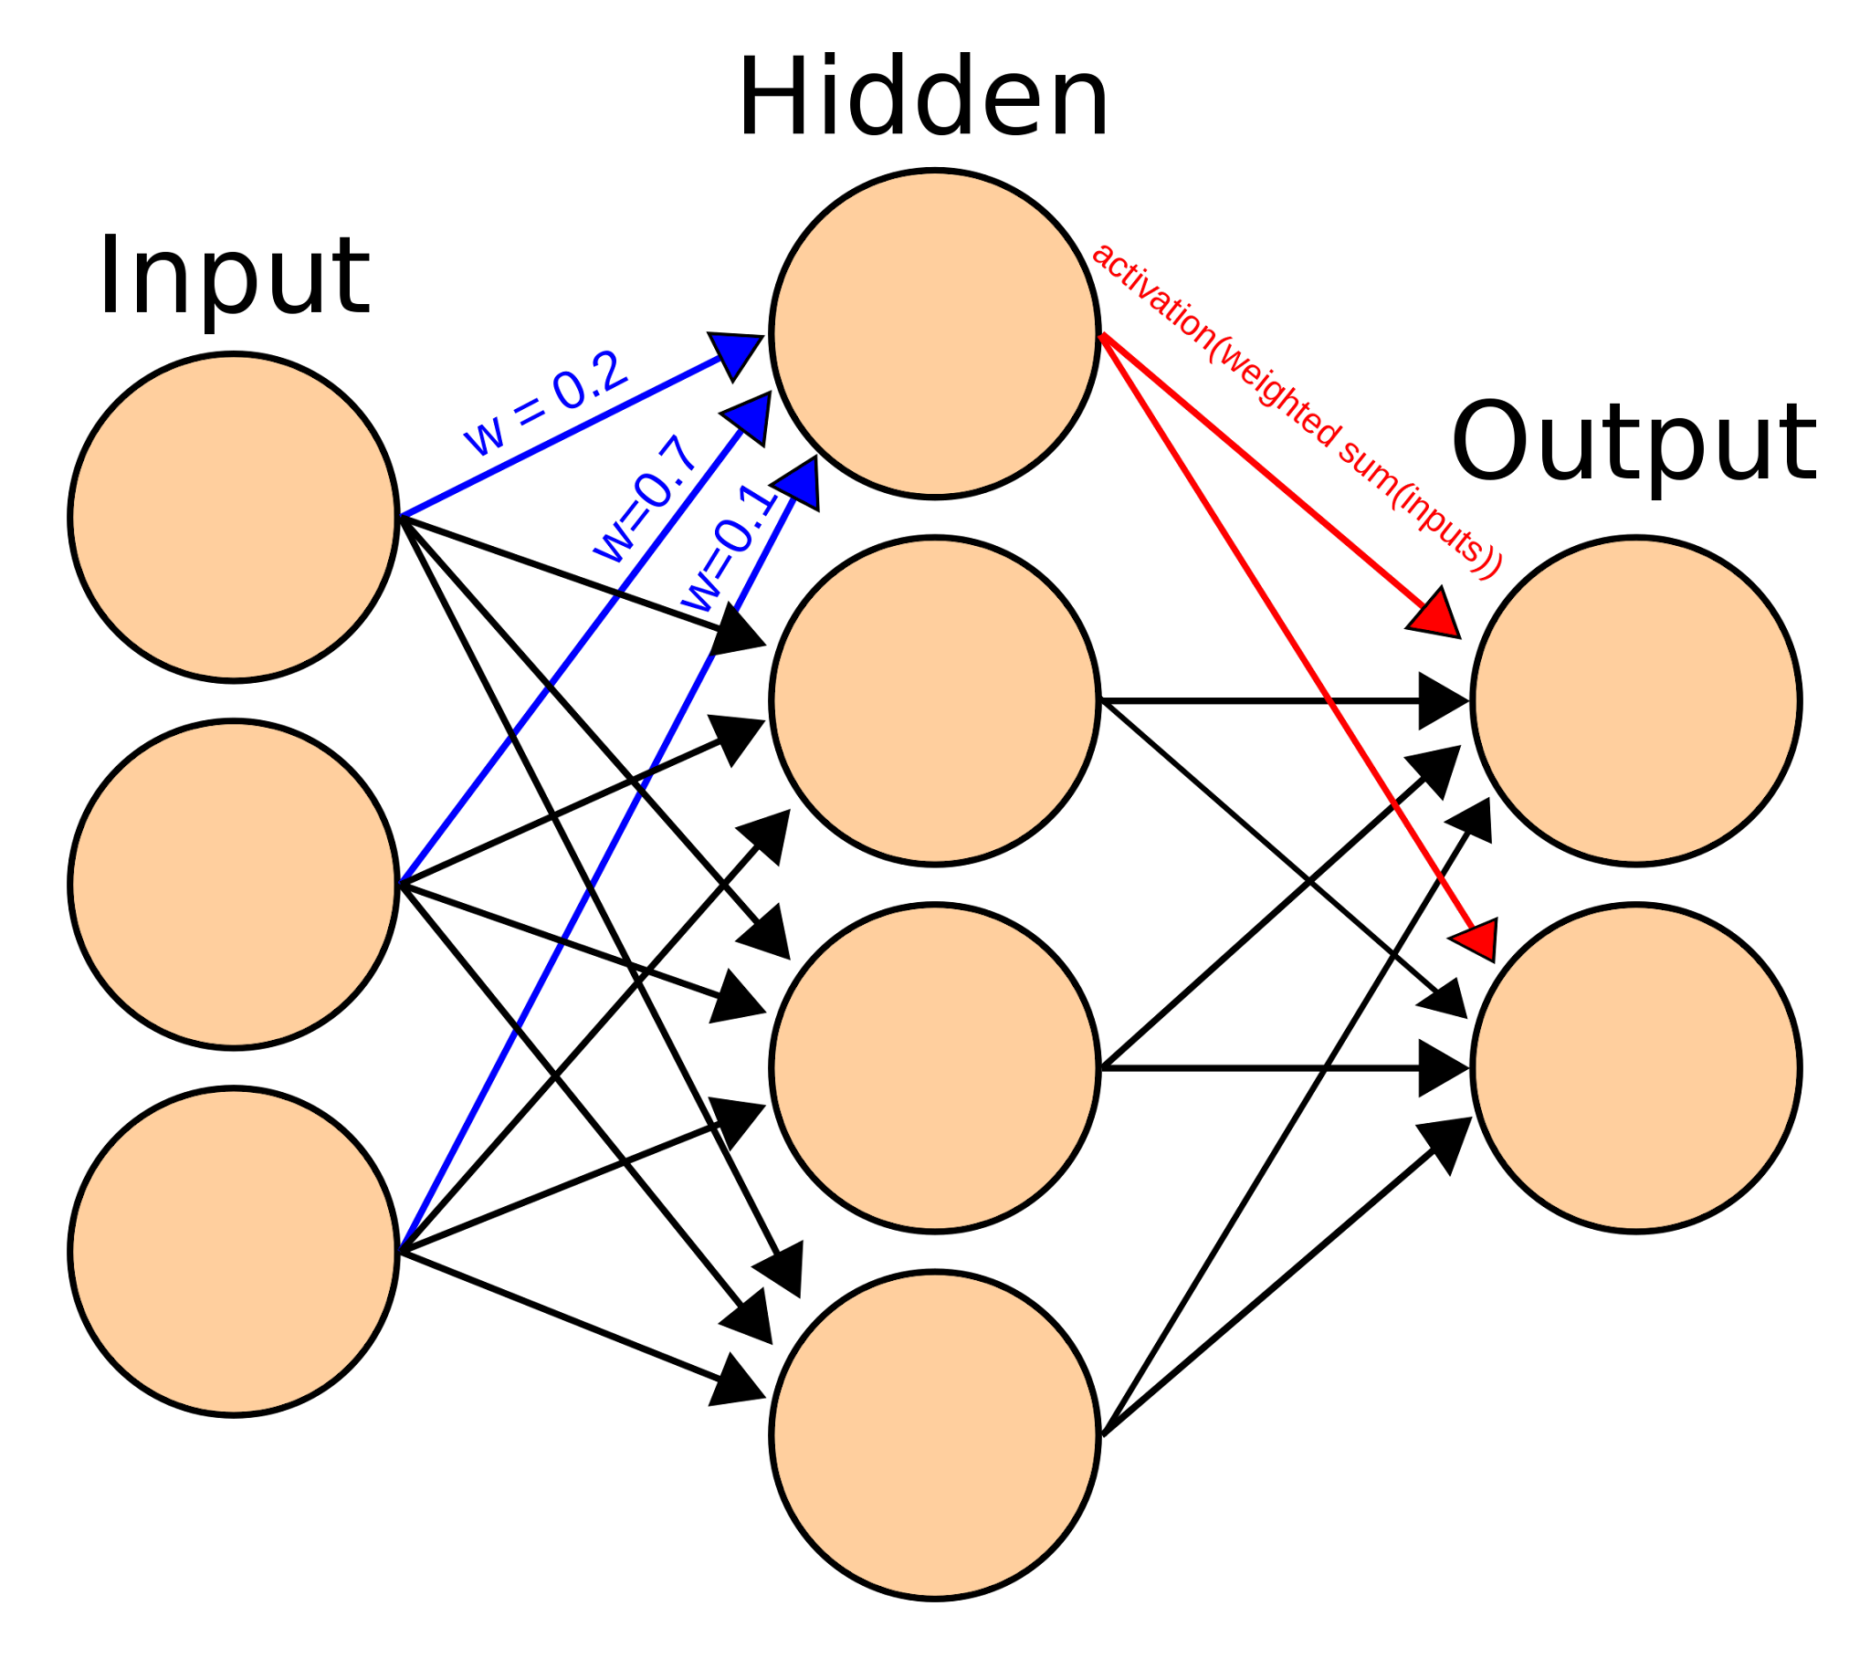
Model Architecture and Training
Notes:
In this project, we leverage the power of BERT, a transformative architecture in the NLP domain. Our BERT model is fine-tuned specifically for Question Answering tasks. The model takes in tokenized questions and their corresponding context. Through its deep neural layers, it predicts the start and end positions of potential answers within the context. Training this model is an iterative process. In each loop, the model's predictions are optimized using a defined loss function. We also ensure that we save model checkpoints at regular intervals, allowing us to revert or continue from specific points in the training. This architecture and training process equips our model to accurately locate answers to a wide range of questions.

Slide 6

Model Evaluation
The Final model was evaluated based on F1 and exact match metrics
Traditional metrics may not tell the whole story, as similar answers may still be correct and understandable
question answering remains a challenging problem, and further research is needed to achieve higher accuracy.
Notes:
After fine tuning the model on the training model, the output accuracy was tested on a validation set. The accuracy of the chatbot answers compared to the ground truth answers was measured in F1 score and exact match score.
The final F1 score was 0.166, while the exact match was 0.12.
While these scores are certainly low, traditional metrics may not be an accurate depiction of a chatbots success rate, as similar answers may still be correct and understandable by the human user
Low metrics suggest that while BERT serves as a powerful model for a wide range of NLP tasks, question answering remains a challenging problem, and further research is needed to achieve higher accuracy.

Slide 7
Chatbot Interface
The Central Component
Gradio Interface
Use of user friendly interactive interface
GPT-3's API to obtain text completions based on this chat history
A Sequence of Operations
Chat History
Stored memory of Quanda Chatbot
- Input
-Building Context
-Response Generated
Notes:
To make 'Quanda' user-friendly, we've harnessed the power of Gradio, an interactive interface creation library. It's what you see when you interact with 'Quanda.' The interface consists of two text boxes, one for user input and the other for chatbot responses. Additionally, we've taken it a step further by including a third text box displaying the conversation history. This feature ensures that users have full context of the ongoing conversation.

Slide 8
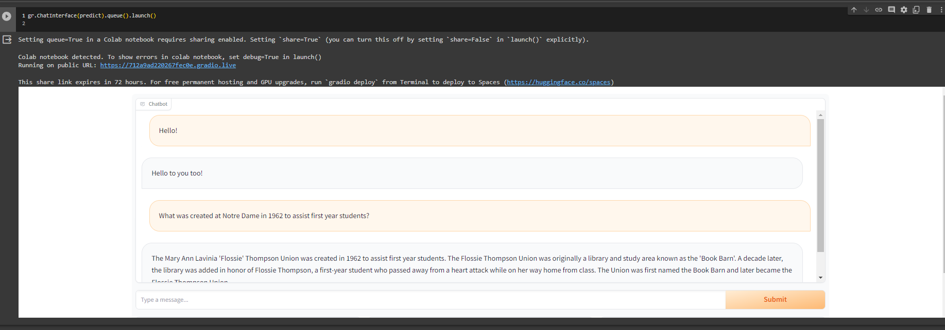
Chatbot Function
Notes:
In this slide, we'll take a closer look at how the 'Quanda' chatbot function operates
At the heart of 'Quanda' lies the chat history. It's like the memory of our chatbot. When a user interacts with 'Quanda,' their inputs are recorded and appended to the chat history. This is crucial for the chatbot to understand the context of the conversation.
The chatbot function follows a clear sequence of operations. First, the user's input is added to the chat history, building context. Then, GPT-3 is summoned to generate a response. It's important to note that the chat history, which includes both user inputs and chatbot responses, serves as the prompt for generating meaningful responses. Additionally, we can control the length of responses using the 'max_tokens' parameter.

Slide 9
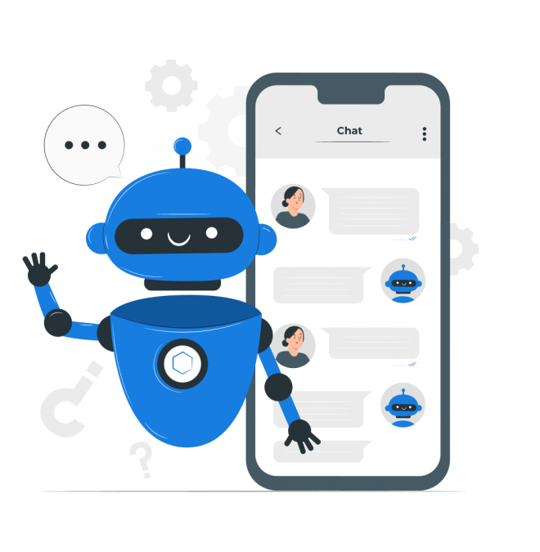
Chatbot Function
GPT 3
Open AI
Response Length
Notes:
At the core of 'Quanda' lies GPT-3, a generative pre-trained transformer developed by OpenAI. GPT-3 is designed to understand human language, generate text, and make context-aware responses. This technology is what enables 'Quanda' to converse with users in a human-like manner
The integration of the OpenAI API allows 'Quanda' to access GPT-3's capabilities seamlessly. It's like 'Quanda' is connected to a powerful language understanding engine, ready to assist with a wide range of user queries
Furthermore we've added the 'MAX_TOKENS' parameter within the Gradio interface to give us control over the length of responses. This parameter enables us to fine-tune how concise or detailed the chatbot's replies should be.

Slide 10
Conclusions & Recommendations
Findings
BERT model
Promise but low metrics
Gradio library
easy and effective user interface
Further improvements
Using different models to explore differences
accuracy metrics
long term conversational context
Notes:
From working with the BERT and Quanda architectures we learned many lessons about the creation and limitations of Chatbots. While BERT, with its bidirectional capabilities and pre-trained knowledge, provided a strong foundation, achieving high accuracy in question answering remains a complex problem. The creation of "Quanda" demonstrates the feasibility of developing chatbots using advanced NLP models that are fine tuned to specific needs with structured datasets. Using the Gradio library was a simple process to create a high quality interface which was able to present the functionality of the model in a pleasing way
For future work to improve the project, we would target higher performance and better conversational context tracking by exploring different models such as T5 or XLnet. One limitation on our work was the computational complexity, so a lighter weight version of a model like DistilBERT may allow for longer training and higher performance, and would also help in scalability.

Slide 11
Team Contributions
Andrew Frederick | Mike Moll | Manahil Nasim
Background Research: Datasets & Models Report Presentation | Background Research: Transformer Models Data Preprocessing & Model Transformation Report Presentation | Background Research: Models & Chatbot Interface Data preprocessing Chatbot Interface Report Presentation
Notes:
Team contributions:
Andrew Frederick: Background Research on Datasets & Models, Final Report, and Presentation.
Mike Moll: Background Research: Transformer models, Data Preprocessing & Model Transformation, Final Report, Code for presentation, and Presentation
Manahil Nasim: background research: models and chatbot interface, data preprocessing, chatbot interface, final report, and presentation.

Slide 12

Demo Video
Notes:
In this video you can see a brief demonstration of our generative chatbot at work. We have successfully incorporated a front end graphical user interface. You can see the chatbot is successfully answering questions.

